Slide 1
Exemption AdministrationTraining
Related to Accepting Certificates
Prepared by the
Streamlined Sales Tax Governing Board
Audit Committee
Prepared January 2011
Revised May 2011 and March 2014
AD14004

Slide 2
Streamlined Sales and Use Tax Agreement (SSUTA)
States adopting the SSUTA are required to administer sales tax exemption certificates in compliance with the provisions of SSUTA (i.e., § 317).
Sellers that comply with the exemption certificate provisions of SSUTA are relieved of any liability for an otherwise taxable transaction.
A purchaser remains liable for the tax on an erroneously claimed exemption (including any applicable penalties and interest).

Slide 3
Exemption Certificates
Satisfy the seller’s responsibility to sell a product without collecting tax from a purchaser and preventing the seller from subsequently being liable for the sales and use tax on that sale.
Allows purchasers to claim an exemption from tax for the purchase of a taxable product and to accept responsibility for any subsequent tax liability on the purchase.
Come in various forms and versions.
Example of the SSUTA Exemption Certificate is on the next slide.
3

Slide 4
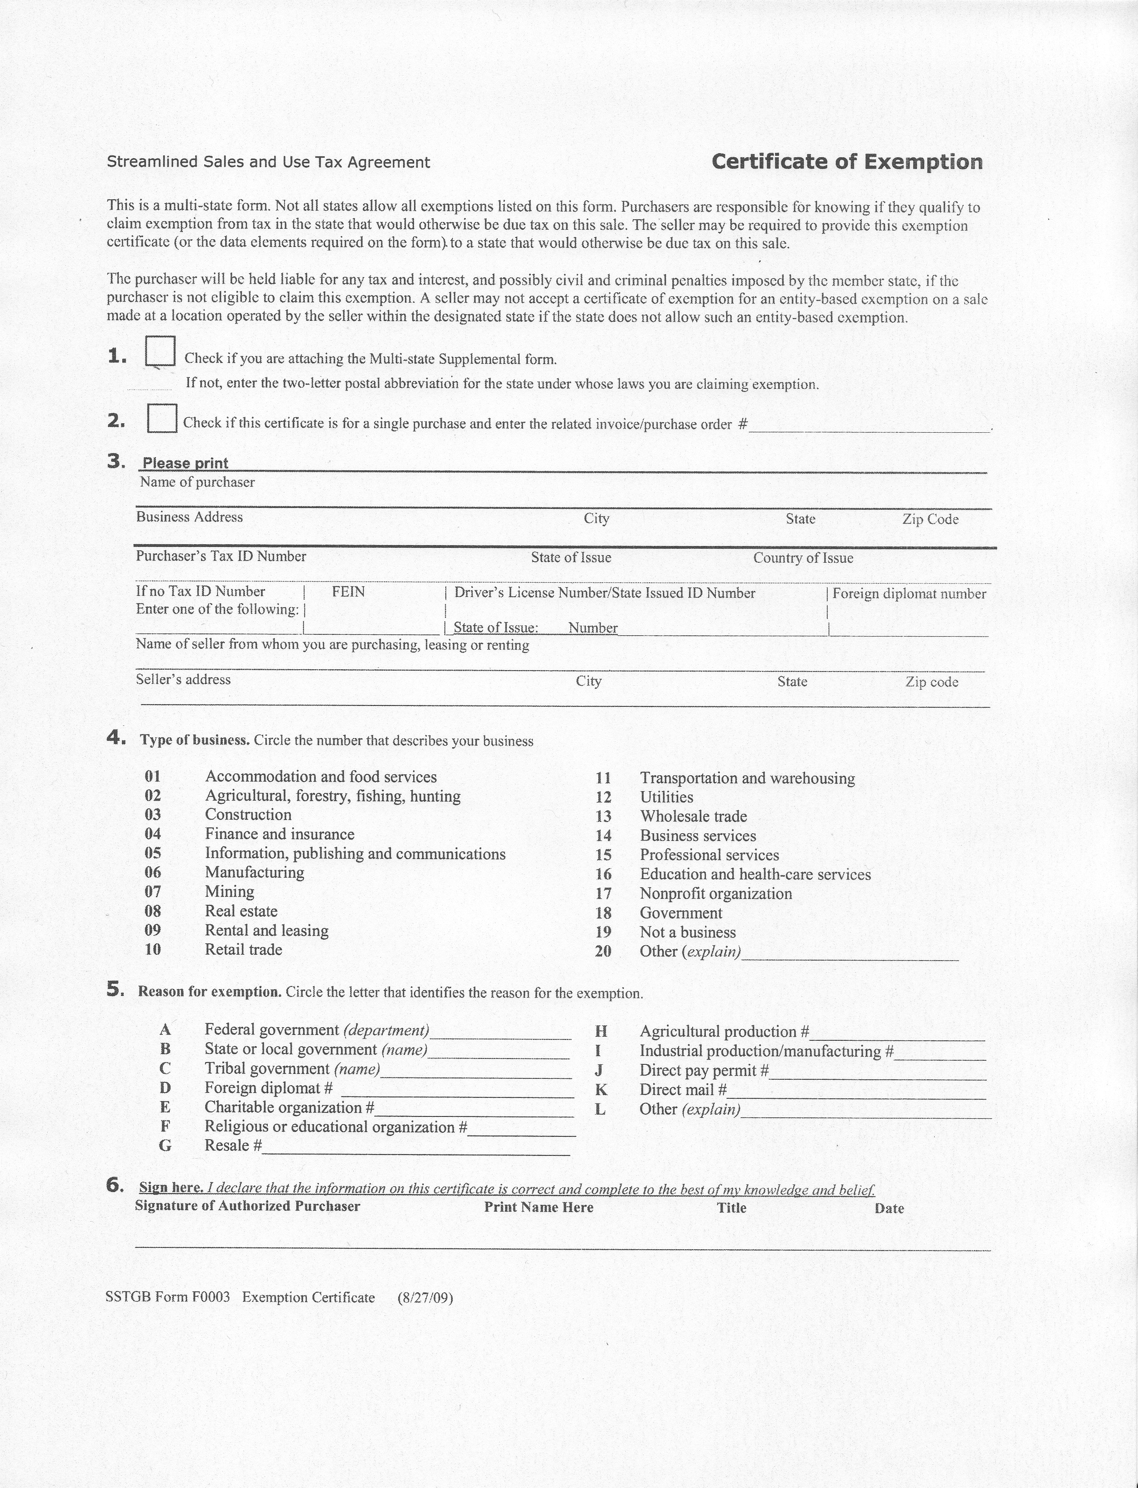
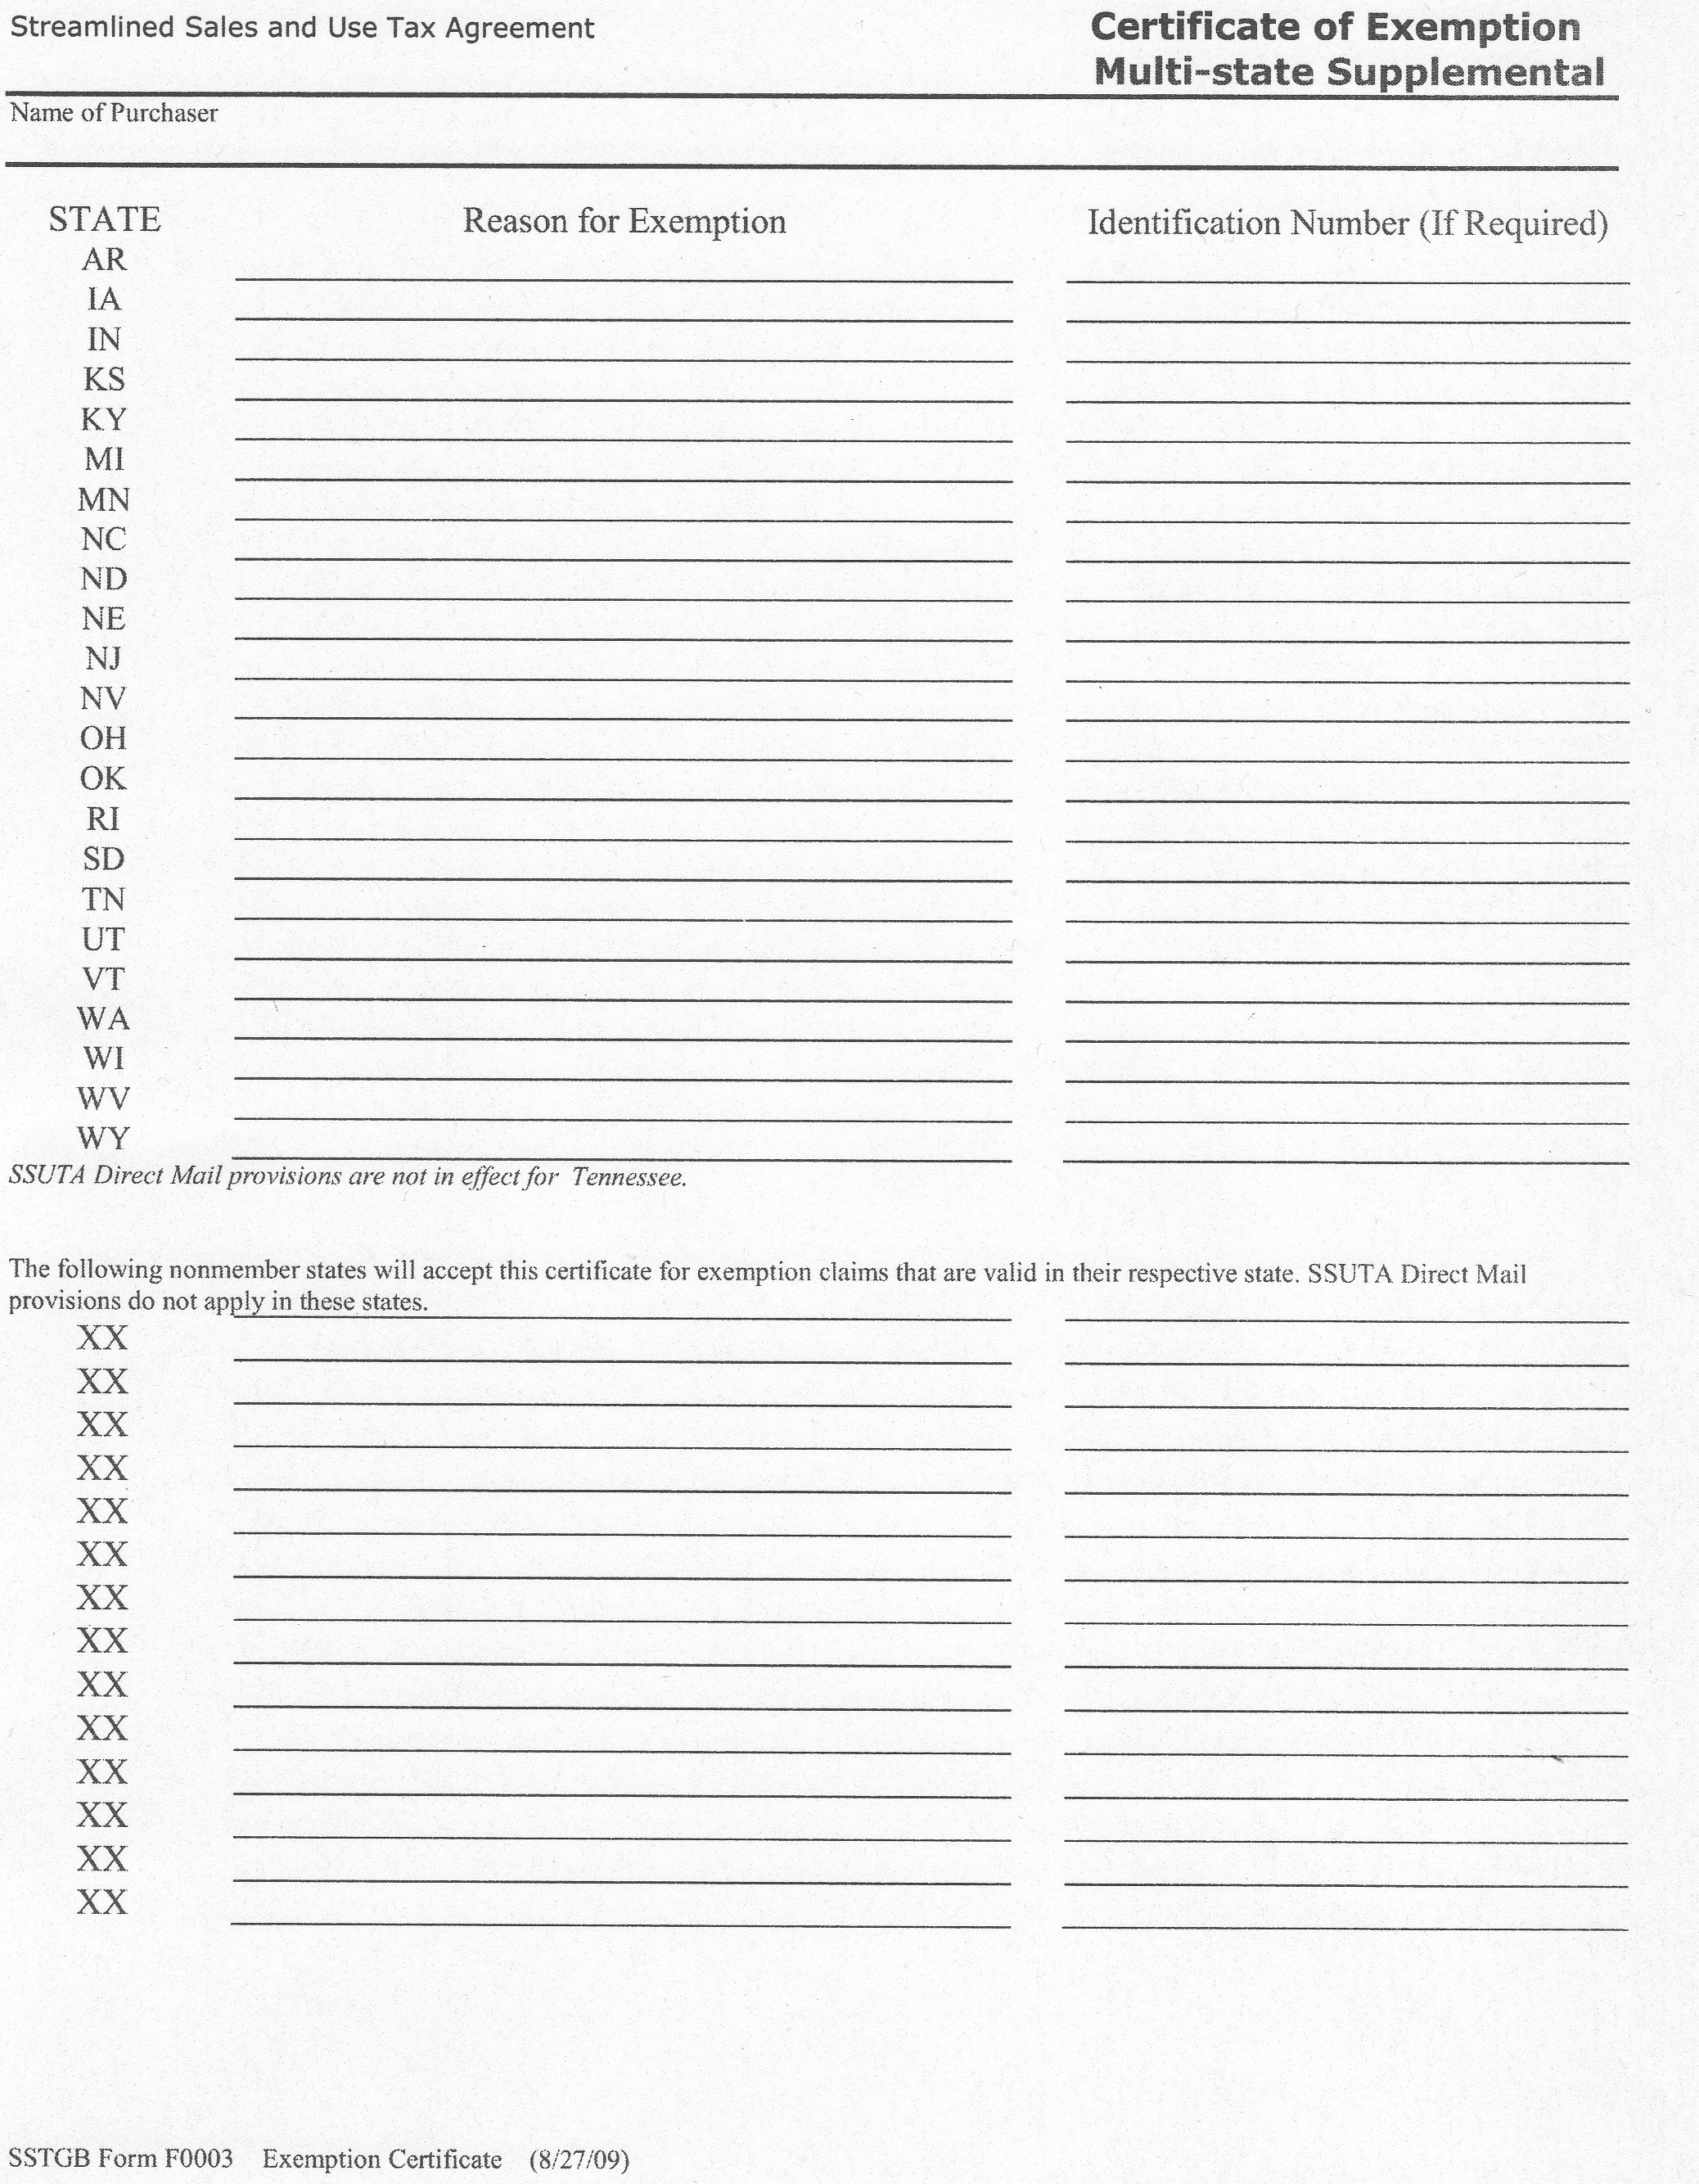
SSTGB Form F0003, SSUTA Certificate of Exemption

Slide 5
Other Exemption Forms
State issued exemption certificate/permit
Previous versions of state exemption forms
Letter of Exemption issued by some states
Multijurisdictional Uniform Sales & Use Tax Certificate – issued by the Multistate Tax Commission (if accepted by the state)
Other documentation acceptable to the state.
5

Slide 6
What information is required for an “Exemption Certificate”?
A seller is required to collect the information required by Sec. 317 of the SSUTA and its corresponding rule. A paper exemption certificate does not have to be used.
Regardless of the type of certificate a seller obtains from a purchaser, Streamlined or state issued, the seller has a “fully completed” exemption certificate if seller captures the information on the form that is part of the Agreement’s required standard data elements.
6

Slide 7
Exemption Certificate Requirements (Member States)
Under the Agreement, a seller has a valid exemption certificate if the seller obtains the following information (standard data elements) from a purchaser (can be retained via paper or electronically):
  Purchaser’s name and address;
  Type of business (see Rule 317.1.A.2 for specific business types);
  Reason(s) for exemption (see Rule 317.1.A.4 for exemption types);
  ID number required by the state where the sale is sourced; and
  If paper is used (including fax), signature of the purchaser.
Note: The seller’s name and address are not required and should not be considered when determining if certificate is fully complete.
Note: A seller that enters data elements from paper into an electronic format is not required to retain the paper certificate.

Slide 8
Exemption Certificate Requirements (Member States)
A member state may require a purchaser to provide an identification number to the seller at the time of the sale to claim exemption. However, a seller is not required to verify the identification number.
A member state may allow direct pay permits, exemption certificates, or another means as proof of exemption that does not burden sellers.
A member state shall allow all sellers (instate and out-of-state sellers) to accept the SSUTA exemption certificate form.
Each member state required to post the form on the state revenue agency’s website
Member states shall gray out any entity-based exemptions that are not applicable in their state when they post the SSUTA Exemption Certificate on their website.
8

Slide 9
Purchaser Identification Number Requirements
A state is permitted to require a seller to provide a purchaser ID number. Purchaser’s identification number use is based on the location where the sale is sourced by the seller. The state where the sale product is sourced can use one of the following types of identification:
State-issued business number (e.g., sales/use tax ID number or SST ID #);
State-issued exemption number;
State-issued driver’s license number; or
U.S. Federal ID Number (e.g., FEIN, but a state cannot request a purchaser’s SSN). A foreign government ID number can be used to claim a resale for purchases of services (excluding services to real or personal property)
Note: a seller is not required to verify a purchaser’s identification. A member state is required to notify the Governing Board and the public as to its ID number requirements

Slide 10
Purchaser’s Type of Business Requirements
A description of the purchaser’s type of business or organization using the business type code defined in section 317.1(A)(2) of the SSTGB Rule on the exemption certificate, and
The reason for exemption using the reason code defined in section 317.1(A)(4) of the SSTGB Rule on the exemption certificate, subject to each state’s availability of the claimed exemption.
10

Slide 11
Fully Completed
Exemption Certificates
The fully complete standard applies to exemption certificates received:
on the date of the sale, or
received within 90 days after the date of the sale.
Note: The seller’s name and address are not required and should not be considered when determining if certificate is fully complete.

Slide 12
Can an Otherwise Complete Exemptions Certificate Still be Invalid?
Yes, a member state is not required to accept an otherwise complete exemption certificate if the seller:
  Fraudulently fails to collect the tax, or
  Solicits purchasers to participate in the unlawful claim of an exemption, or
  At a retail location in the member state, accepts a certificate that the state has affirmatively indicated an entity-based exemption is not available in the state (note this does not apply to remote sales - sales occurring outside the member state).
12

Slide 13
Invalid Exemption Certificates that are Fully Complete
Absent of fraud on the seller’s part, if the purchaser provides a fully completed exemption certificate to the seller within 90 days of the sale, the state auditor must accept the certificate.
If the state auditor believes the exemption claimed is invalid, obtain as much information as possible about the transaction and follow applicable procedures for possible assessment against the purchaser.

Slide 14
Incomplete and Missing
Exemption Certificates
States may require the seller obtain complete certificates (or other acceptable documentation) to replace incomplete certificates.
If no certificate is on file, treat the sale as taxable according to state law.
14

Slide 15
120-Day Rule
Within 120 days after receiving a request for substantiation of exempt sales from a member state, a seller with missing or incomplete exemption certificates must provide:
  fully completed exemption certificate taken in good faith from the purchaser, or
  other information acceptable to the state establishing that the transaction was not subject to the tax.

Slide 16
120-Day Rule
The 120-day rule starts subsequent to a request for substantiation by a member state of missing or incomplete certificates.
A general notice of intention to conduct an audit on a seller’s exempt sales is not sufficient to trigger the start of the “120-day” period.

Slide 17
Good Faith Standards
“Good faith” means that the exemption claimed on an exemption certificate must be:
statutorily available on the date of the transaction in the jurisdiction where the transaction is sourced,
applicable to the item being purchased, and
reasonable for the purchaser’s type of business.
17

Slide 18
Good Faith Standards
Member states may use the “good faith” standard when reviewing exemption information received after the seller was notified of the “120-day” period to obtain missing or incomplete certificates.
The “good faith” standards do not apply when reviewing fully completed exemption certificates received at the time of sale or within 90-days from the date of sale.

Slide 19
Good Faith Standards
  Member states may allow for periods longer than the minimum
    90 days from the date of sale to obtain fully completed exemption certificates to be relieved of tax liability otherwise applicable, or
    120 days after the request to substantiate missing certificates or other acceptable documentation.
A member state is not required to apply the “good faith” standard to fully completed exemption certificates.
Application of the “good faith” standard to exemption certificates received after the 90-day period from the date of sale is based on state policy, procedure, or law.
19

Slide 20
Handling Exemption Certificates in an Audit
If an exemption certificate is subject to “good faith standards,” an auditor can examine the validity of the certificate (or other documentation retained by a seller).
A certificate (or other documentation) can be considered invalid if:
Not complete (still complete if all SSUTA Exemption Certificate information on the form is provided);
Exemption claimed does not exist; or
Not reasonable for the seller to believe that the purchaser is entitled to the exemption.

Slide 21
Relief from Tax Liability (State Option)
Member states must provide sellers relief from tax liability for an exempt transaction if the seller provides a fully completed exemption certificate received at the time of sale, or within 90 days of the sale, or other documentation.
Exception: Liability is not relieved even if received within 120 days of notice if:
  the seller had knowledge or had reason to know that the information provided was materially false, or
  the seller knowingly participated in activity intended to purposefully evade the tax.

Slide 22
Relief from Tax Liability (Business Option)
The seller is relieved of any tax liability for an exempt transaction if it provides the exemption certificate or acceptable exemption information within the 120 days of notice. A state may provide sellers with more than 120-days; that period is the minimum time a state must provide a seller to obtain complete exemption information.
Exception: Liability is not relieved even if received within 120 days of notice if:
  the seller had knowledge or had reason to know that the information provided was materially false, or
  the seller knowingly participated in activity intended to purposefully evade the tax.
22

Slide 23
Burden of Proof Claiming a Certificate is Materially False Within 120-day Period
The state must establish that the seller had knowledge or had reason to know at the time the information was provided that the information was materially false for a transaction to be considered taxable.

Slide 24
Blanket Exemption Certificate
Member state shall allow blanket exemption certificates for all exemption purposes.
Member states may require purchasers to update exemption certificate information or to reapply with the member state to claim certain exemptions.
Member states may not request from sellers renewal of blanket certificates or updates of exemption certificate information or data elements when there is a recurring business relationship between the purchaser and seller.
A recurring business relationship exists when a period of no more than twelve months elapses between sales transactions.

Slide 25
Drop Shipment Rule
A state shall allow a third party vendor (e.g., drop shipper) to claim a resale exemption based on an exemption certificate provided by its customer/re-seller, or any other acceptable information available to the third party vendor, showing the sale qualifies for a resale exemption.
The exemption is allowed to the third party vendor regardless of whether the customer/re-seller is registered to collect and remit sales and use tax in your state.

Slide 26
References and Resources
Information based on the Streamlined Sales and Use Tax Agreement – Section 317 – Administration of Exemptions
Section 317.1 – Simplified Administration Process
Form F0003 – Certificate of Exemption
(Both items are found at www.streamlinedsalestax.org )
Multijurisdiction Uniform Sales & Use Tax Certificate
can be found at www.mtc.gov (Select resources and forms)
Your State’s laws and regulations.

