Slide 1
E-Fairness: Washington Update
Prepared for
Streamlined Sales Tax Governing Board (SST)
May 7, 2019

Slide 2
116th Congress

Slide 3
Congressional Turnover
High congressional turnover in the midterm elections, partially due to retirements of long-serving members
Congressional candidates today are more likely to have never served in an elected office prior to running for Congress
Will new members know about the SST’s mission and the SCOTUS decision?
Notes:
WM-
Made a note of McCain’s death in the Senate, but noted the seat was filled and special election won’t be held for that seat until 2020

Slide 4
2019 Congressional Outlook
Key Policy Focus for 2019:
Fiscal Year 2020 Appropriations
Defense Reauthorization
Judicial Nominations
Tax Extenders
Trade
Healthcare Costs
Budget Reform
Data Privacy
Broadband Deployment
Administration Oversight

Slide 5
U.S. Senate

Slide 6
116th Congress U.S. Senate
100 Senators
53 Republicans
47 Democrats
(47 + 2 Independents)

Slide 7
8 Newly Elected Senators
Seats Flipped
FL: Rick Scott (R) defeated incumbent Bill Nelson (D)
IN: Mike Braun (R) defeated incumbent Joe Donnelly (D)
MO: Josh Hawley (R) defeated incumbent Claire McCaskill (D)
NV: Jacky Rosen (D) defeated incumbent Dean Heller (R)
ND: Kevin Cramer (R) defeated incumbent Heidi Heitkamp (D)
Open Seats (No Party Change)
TN: Marsha Blackburn (R) defeated Phil Bredesen (D)
UT: Mitt Romney (R) defeated Jenny Wilson (D)
Open Seats (With Party Change)
AZ: Kyrsten Sinema (D) defeated Martha McSally (R)

Slide 8
Three Rotating Senate “Classes”
Class II (33) | Class III (34) | Class I (33)
Term Expires January 2021
12 Democrats
21 Republicans
Term Expires January 2023
12 Democrats
22 Republicans
Term Expires January 2025
21 Democrats
10 Republicans
2 Independents
Note: 6-year terms for all U.S. Senators
Notes:
SC senators are Class II and Class III

Slide 9
Senate Finance Committee Current Ratio: 15-13
Republicans
Chuck Grassley (IA), Chair (4 C, 6 RM)
Mike Crapo (ID)
Pat Roberts (KS)
Mike Enzi (WY)
John Cornyn (TX)
John Thune (SD)
Richard Burr (NC)
Johnny Isakson (GA)
Rob Portman (OH)
Pat Toomey (PA)
Tim Scott (SC)
Bill Cassidy (LA)
James Lankford (OK)
Steve Daines (MT)
Todd Young (IN)
Democrats
Ron Wyden (OR), Ranking
Debbie Stabenow (MI)
Maria Cantwell (WA)
Bob Menendez (NJ)
Tom Carper (DE)
Ben Cardin (MD)
Sherrod Brown (OH)
Michael Bennet (CO)
Bob Casey (PA)
Mark Warner (VA)
Sheldon Whitehouse (RI)
Maggie Hassan (NH)
Catherine Cortez Masto (NV)
New Committee Member
C = Years as Chair of Committee
RM = Year as Ranking Member
Committee Seniority over Chair/Ranking Member

Slide 10
Senate Appropriations Committee Current Ratio: 16-15
Republicans
Richard Shelby (AL), Chair (2 C, 2 RM)
Mitch McConnell (KY)
Lamar Alexander (TN)
Susan Collins (ME)
Lisa Murkowski (AK)
Lindsey Graham (SC)
Roy Blunt (MO)
Jerry Moran (KS)
John Hoeven (ND)
John Boozman (AR)
Shelley Moore Capito (WV)
John Kennedy (LA)
Cindy Hyde-Smith (MS)
Steve Daines (MT)
Marco Rubio (FL)
James Lankford (OK)
Democrats
Patrick Leahy (VT), Ranking
Patty Murray (WA)
Dianne Feinstein (CA)
Dick Durbin (IL)
Jack Reed (RI)
Jon Tester (MT)
Tom Udall (NM)
Jeanne Shaheen (NH)
Jeff Merkley (OR)
Chris Coons (DE)
Brian Schatz (HI)
Tammy Baldwin (WI)
Chris Murphy (CT)
Joe Manchin (WV)
Chris Van Hollen (MD)
New Committee Member
C = Years as Chair of Committee
RM = Year as Ranking Member
Committee Seniority over Chair/Ranking Member

Slide 11
U.S. House of Representatives

Slide 12
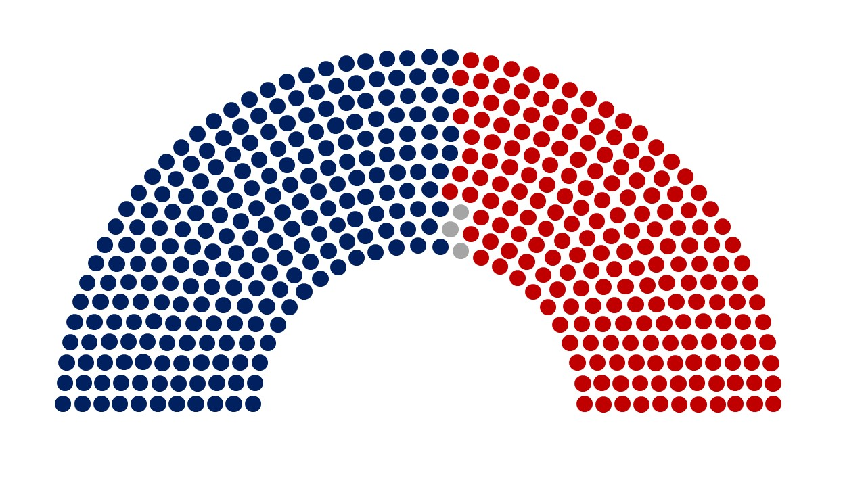
116th Congress U.S. House of Representatives
435 Representatives
235 Democrats
197 Republicans
3 Vacancies
Notes:
WM-
Updated the number of vacancies

Slide 13
U.S. House of Representatives Overview
435 total Members
235 Democrats
197 Republicans
(3 Vacancies)
~ 38 seat difference
House members run for reelection every 2 years
Can be dependent on national trends, more so than Senators
House Democrats regained control in 2018
60% of the House Democratic Caucus has never served in the Majority
73% of the House Republican Conference has never served in the Minority
70% of House Republicans have never served under a Republican President
Notes:
WM-
Updated the breakdown of members in the House and current vacancies

Slide 14
U.S. House of Representatives Overview
Democrats picked up a net of 40 seats
43 seats held by Republicans flipped to Democrats
CA, IL, IA, ME, MI, NJ, NY, PA, VA
3 seats held by Democrats flipped to Republicans
MN and PA
92 confirmed new Members
21% of the House are now newly elected members

Slide 15
House Judiciary Committee Current Ratio: 24-17
Democrats
Jerry Nadler (NY), Chair
Zoe Lofgren (CA)
Sheila Jackson Lee (TX)
Steve Cohen (TN)
Hank Johnson (GA)
Ted Deutch (FL)
Karen Bass (CA)
Cedric Richmond (LA)
Hakeem Jeffries (NY)
David Cicilline (RI)
Eric Swalwell (CA)
Ted Lieu (CA)
Jamie Raskin (MD)
Pramila Jayapal (WA)
Val Demings (FL)
Lou Correa (CA)
Mary Gay Scanlon (PA)
Sylvia Garcia (TX)
Joe Neguse (CO)
Lucy McBath (GA)
Greg Stanton (AZ)
Madeleine Dean (PA)
Debbie Mucarsel-Powell (FL)
Veronica Escobar (TX)
Republicans
Doug Collins (GA), Ranking
Jim Sensenbrenner (WI)
Term-limited
Steve Chabot (OH)
Louie Gohmert (TX)
Jim Jordan (OH)
Ken Buck (CO)
John Ratcliffe (TX)
Martha Roby (AL)
Matt Gaetz (FL)
Mike Johnson (LA)
Andy Biggs (AZ)
Tom McClintock (CA)
Debbie Lesko (AZ)
Guy Reschenthaler (PA)
Ben Cline (VA)
Kelly Armstrong (ND)
Greg Steube (FL)
New Committee Member

Slide 16
House Appropriations Committee Current Ratio: 30-23
Democrats
Nita Lowey (NY), Chair
Marcy Kaptur (OH)
Pete Visclosky (IN)
Jose Serrano (NY)
Rosa DeLauro (CT)
David Price (NC)
Lucille Roybal-Allard (CA)
Sanford Bishop (GA)
Barbara Lee (CA)
Betty McCollum (MN)
Tim Ryan (OH)
C.A. Dutch Ruppersberger (MD)
Debbie Wasserman Schultz (FL)
Henry Cuellar (TX)
Chellie Pingree (ME)
Mike Quigley (IL)
Derek Kilmer (WA)
Matt Cartwright (PA)
Grace Meng (NY)
Mark Pocan (WI)
Katherine Clark (MA)
Pete Aguilar (CA), Vice
Chair
Lois Frankel (FL)
Cheri Bustos (IL)
Bonnie Watson Coleman
(NJ)
Brenda Lawrence (MI)
Norma Torres (CA)
Charlie Crist (FL)
Ann Kirkpatrick (AZ)
Ed Case (HI)
Republicans
Kay Granger (TX), Ranking
Hal Rogers (KY)
Robert Aderholt (AL)
Mike Simpson (ID)
John Carter (TX)
Ken Calvert (CA)
Tom Cole (OK)
Mario Diaz-Balart (FL)
Tom Graves (GA)
Steve Womack (AR)
Jeff Fortenberry (NE)
Chuck Fleischmann (TN)
Jamie Herrera Beutler (WA)
David Joyce (OH)
Andy Harris (MD)
Martha Roby (AL)
Mark Amodei (NV)
Chris Stewart (UT)
Steven Palazzo (MS)
Dan Newhouse (WA)
John Moolenaar (MI)
John Rutherford (FL)
Will Hurd (TX)
New Committee Member

Slide 17
E-fairness Federal Initiatives

Slide 18
E-fairness Legislative Action (2017-2018)
SST participated in 121 meetings with House and Senate members and staff in the 115th Congress (2017-2018).
SST advised House and Senate stakeholders about SCOTUS amicus brief submissions.
Provided feedback about the SSUTA and participating states’ activities.
Tracked e-fairness critics’ comments and briefs and shared with interested parties.
Multiple federal legislative bills were introduced during the 115th Congress.
4 House bills (2 pre-SCOTUS decision, 2 post-SCOTUS decision)
2 Senate bills (1 pre-SCOTUS decision, 1 post-SCOTUS decision)
Committee hearings held, but no legislative action taken.
House Judiciary Subcommittee on Regulatory Reform, Commercial, and Antitrust Law – July 25, 2017
House Judiciary Committee – July 24, 2018
Wayfair v. South Dakota SCOTUS decision has not stopped Congressional interest in e-fairness.
Notes:
WM-
Taxes- mention Tax Reform 2.0?
Trade- Reorganized order from Withdraw from TPP, renegotiations of NAFTA, tariffs to what it is currently listed above

Slide 19
Pre-SCOTUS Decision: E-fairness Legislative Action
SST advocated for the passage of federal legislation that allows for remote sales tax collection.
The Marketplace Fairness Act
The Remote Transactions Parity Act
Worked directly with all interested stakeholders to achieve the ability to collect sales taxes on remote sales.
Notes:
WM-
Taxes- mention Tax Reform 2.0?
Trade- Reorganized order from Withdraw from TPP, renegotiations of NAFTA, tariffs to what it is currently listed above

Slide 20
116th Congress: SST E-fairness Legislative Position
SST is not advocating for federal e-fairness legislation at this time.
Let the states demonstrate that they can and will implement this fairly and in a transparent manner.
Critics’ concerns after the announcement of the South Dakota v. Wayfair SCOTUS decision:
Retroactivity
Small seller exemption levels
Implementation dates by the states
Creating and implementing new state compacts to streamline sales and use tax systems
State overreach
Notes:
WM-
Taxes- mention Tax Reform 2.0?
Trade- Reorganized order from Withdraw from TPP, renegotiations of NAFTA, tariffs to what it is currently listed above

Slide 21
116th Congress: E-fairness Legislative Action
SST participated in 21 meetings with House and Senate members and staff in March 2019.
Focus: New members of the House and Senate, focusing on SST states and committees of jurisdiction.
Multiple federal legislative bills have been introduced at the beginning of the 116th Congress.
2 House bills
1 Senate bill
No legislative action taken to date.
Focus: Committees of jurisdiction and Fiscal Year 2020 Appropriations Process
Wayfair v. South Dakota SCOTUS decision has not stopped congressional interest in e-fairness.
Notes:
WM-
Taxes- mention Tax Reform 2.0?
Trade- Reorganized order from Withdraw from TPP, renegotiations of NAFTA, tariffs to what it is currently listed above

Slide 22
116th Congress: E-fairness Legislative Action
H.R. 379, Protecting Businesses from Burdensome Compliance Cost Act
Introduced: January 9, 2019
Sponsor: Rep. Bob Gibbs (R-OH)
Cosponsors: 1 Republican (Rep. Greg Gianforte (R-MT))
Committee: House Judiciary Committee
SST Position: Oppose
Key aspects of the bill:
Limit the authority of a state to require remote sellers to collect taxes and fees owed by purchasers
Single rate per state
Single point of collection per state
“Nexus” is referring to physical nexus, not economic nexus
Notes:
WM-
Taxes- mention Tax Reform 2.0?
Trade- Reorganized order from Withdraw from TPP, renegotiations of NAFTA, tariffs to what it is currently listed above

Slide 23
116th Congress: E-fairness Legislative Action
S. 128, The Stop Taxing Our Potential (STOP) Act
Introduced January 15, 2019
Sponsor: Jon Tester (D-MT)
Cosponsors: 4 Democrats (Sens. Jeanne Shaheen (D-NH), Jeff Merkley (D-OR), Maggie Hassan (D-NH), and Ron Wyden (D-OR))
Committee: Senate Finance Committee
SST Position: Oppose
Key aspects of the bill:
Imposes a strict physical nexus standard
Overturn the U.S. Supreme Court’s decision (Wayfair v. South Dakota).
Notes:
WM-
Taxes- mention Tax Reform 2.0?
Trade- Reorganized order from Withdraw from TPP, renegotiations of NAFTA, tariffs to what it is currently listed above

Slide 24
116th Congress: E-fairness Legislative Action
H.R. 1933, The Online Sales Simplicity and Small Business Relief Act
Introduced: March 27, 2019
Sponsor: Jim Sensenbrenner (R-WI)
Cosponsors: 4 Democrats (Reps. Anna Eshoo (D-CA), Annie Kuster (D-NH), Zoe Lofgren (D-CA), and Chris Pappas (D-NH)) and 2 Republicans (Reps. Jeff Duncan (R-CA) and Mike Gallagher (R-WI))
Committee: House Judiciary Committee
SST Position: Oppose
Key aspects of the bill:
Prevent retroactive collection (prior to June 21, 2018)
Sets a “small business” exemption of $10 million that will be eliminated upon congressional approval of a state compact on simplification
Relies on an “physical presence” concept struck down by the Supreme Court in South Dakota v. Wayfair
Notes:
WM-
Taxes- mention Tax Reform 2.0?
Trade- Reorganized order from Withdraw from TPP, renegotiations of NAFTA, tariffs to what it is currently listed above

Slide 25
Looking Forward

Slide 26
SST Action Items
State implementation
Congressional education
Champions development
Notes:
Ask Randi for word in highlighted

Slide 27
Questions / Comments
Randi Reid
Kountoupes Denham Carr & Reid
607 14th Street, NW
Suite 750
Washington, DC 20005
(202) 803-4585
randi@kdcrpartners.com
www.kdcrpartners.com

